Slide 1



SHE SAFETY
Stay Vigilant, Stay Safe with our women-centric safety app

Slide 2

CONTENT
01
02
03
04
05
06
07
08
09
10
ABOUT US
PROBLEM STATEMENT
APPROACH TO SOLUTION
FEATURES INCLUDED
TECHNOLOGY USED
UI IMAGES OF THE APP
DEMO VIDEO
USE CASE
FUTURE WORKS
OUR LEARNINGS

Slide 3



ABOUT US
( TEAM – 1 )
Name – Shreya Agrawal
Institution – Graphic Era Deemed to be University, Dehradun
Name – Bhuvana Atmakuri
Institution – KL University,
Vijayawada
`
Name – Gunda Keerthana
Institution – CVR College of Engineering, Hyderabad
Name – Somanaboina Meghana
Institution – CVR College of Engineering, Hyderabad

Slide 4

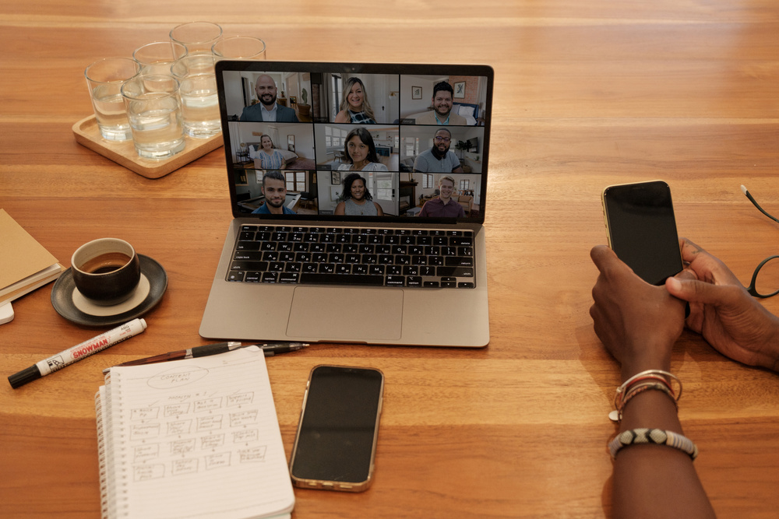

PROBLEM STATEMENT
Problem
Develop a mobile app that enhances women safety, incorporating features such as real time location tracking, emergency alerts and virtual companions for safe travel
Solution
Introducing a women's safety mobile app called SHE SAFETY: real-time location tracking, emergency alerts, emergency contact lists and self defense tutorials

Slide 5




APPROACH TO SOLUTION
We began by identifying key features crucial for women's safety, such as live location tracking and emergency alerts, through collaborative brainstorming sessions.
Boosting user safety awareness, we innovatively introduced location rating. Empowering users with insights on area safety levels.
Iterative design, fueled by stakeholder and user feedback, refines app features, ensuring it aptly meets user safety needs.

Slide 6


FEATURES
01
02
03
04
05
06
Seamless real-time location tracking
Rate locations as safe/unsafe with a safety percentage indicator
SOS Alerts to emergency contacts with live location via SMS
Integrated helpline numbers; user-customizable family contacts
Smooth redirection to phone app for calls
In-app links to self defense tutorials

Slide 7



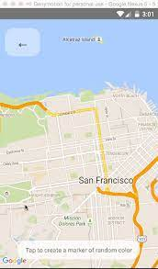


TECHNOLOGY USED
REACT NATIVE
Expo SMS API
React Native Maps
Google API
Async Storage

Slide 8
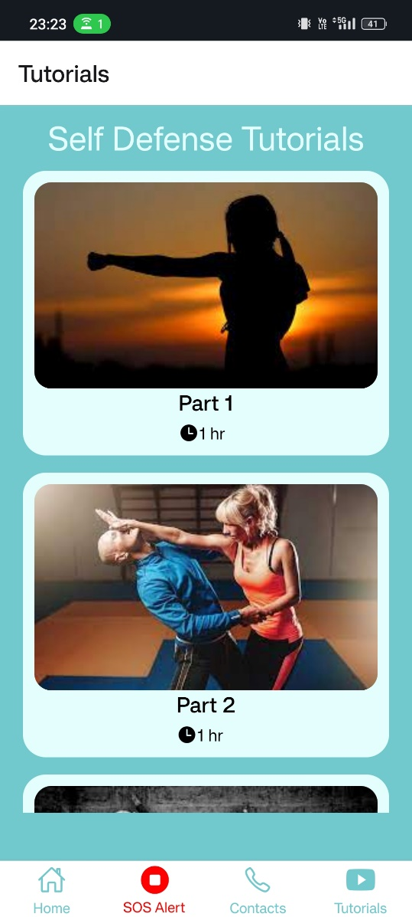
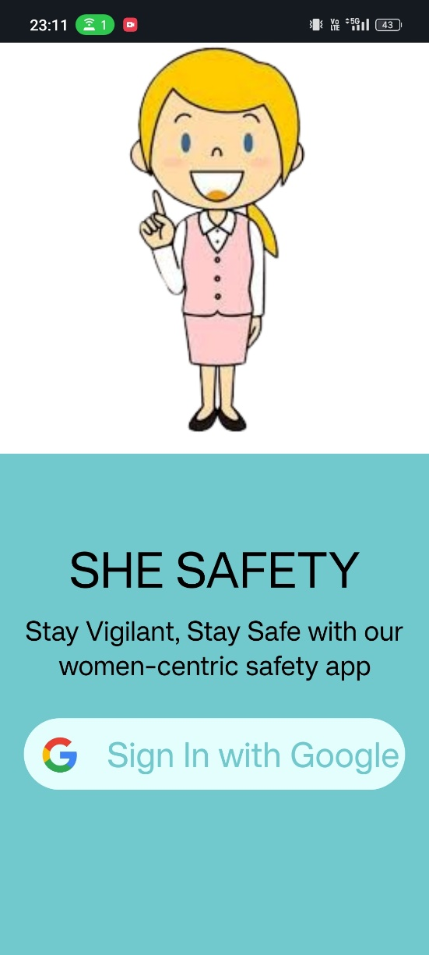
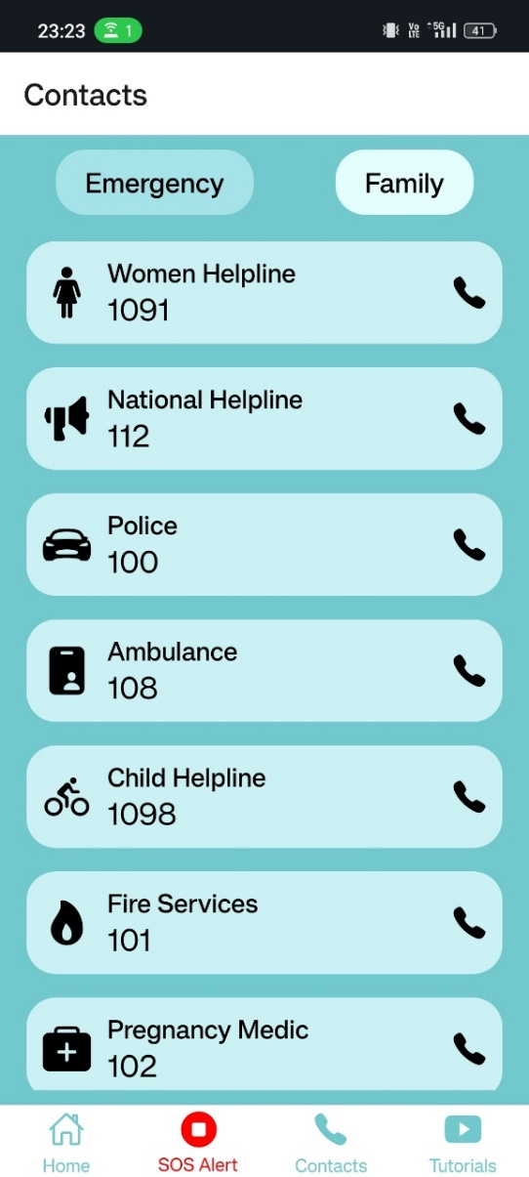

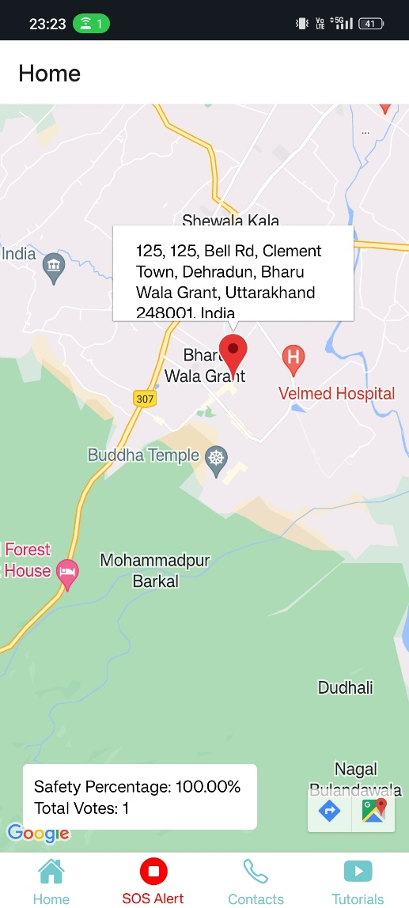
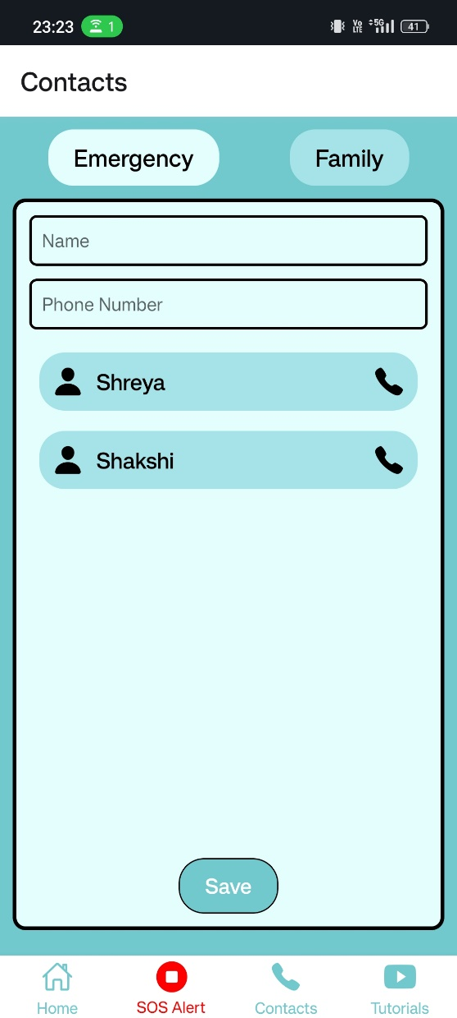
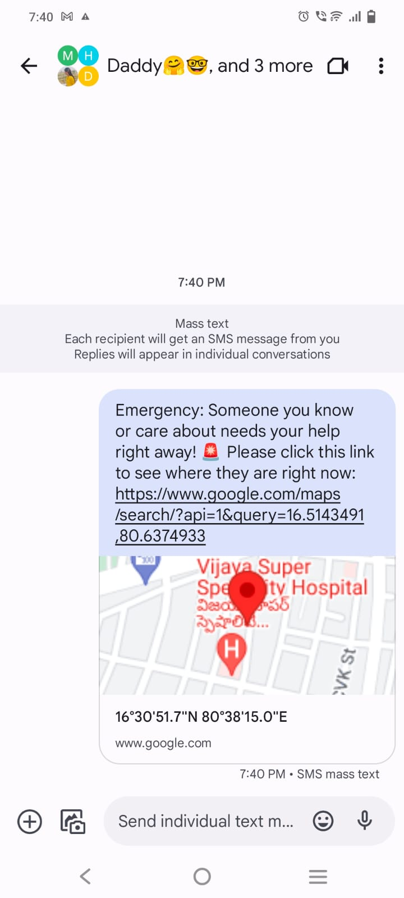
UI DESIGNS
Screen 5
Screen 1
Screen 3
Screen 2
Screen 4
Screen 6

Slide 9

``
DEMO VIDEO

Slide 10


USE CASES OF THE APP
Ensure safety during adventurous trips, solo travels and outdoor activities.
Use for safe travel to and from the workplace, especially during odd hours.
Access helplines and connect with family for immediate assistance.
USE CASES

Slide 11
FUTURE WORKS
Implement color-coded markers on the map to indicate the safety level of areas,
enhancing users' understanding of their surroundings
Integrate voice command activation for the app, enabling users to initiate
functions hands-free for added accessibility
Develop real-time tracking of users' taxi or vehicle travels, displaying driver
details and vehicle number on the map for increased safety during transportation
Provide users with information on nearby safe locations such as police stations
or hospitals to aid in making informed decisions
Automatically share users' live location with emergency contacts when they
enter areas with low safety ratings, ensuring prompt assistance when needed

Slide 12





OUR LEARNINGS
Learning 1
Learning 2
Learning 3
Successfully collaborating with strangers in a virtual space, emphasizing adaptability and open communication.
Employing intentional team-building activities for fostering camaraderie and connection in a remote collaboration setting.
Building a foundation of trust through intentional efforts, despite geographical and cultural differences.

Slide 13

Thank you

